Slide 1
Slides on UCU 2025 strike action
Feel free to edit a copy to fit your students needs and interests!

Slide 2
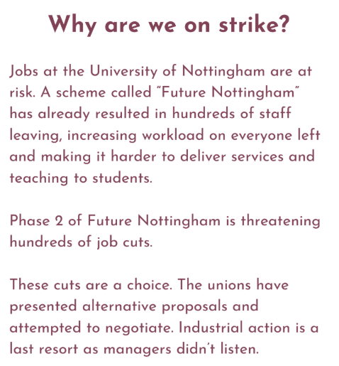
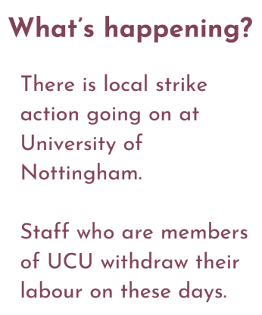


What’s happening?

Slide 3
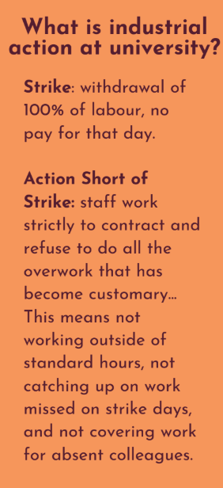
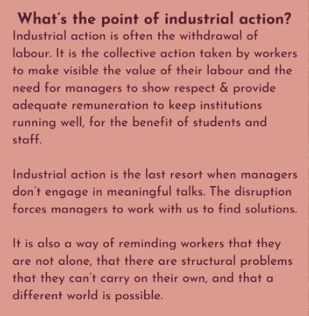

Slide 4
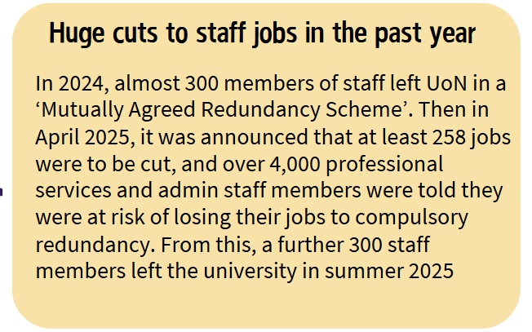
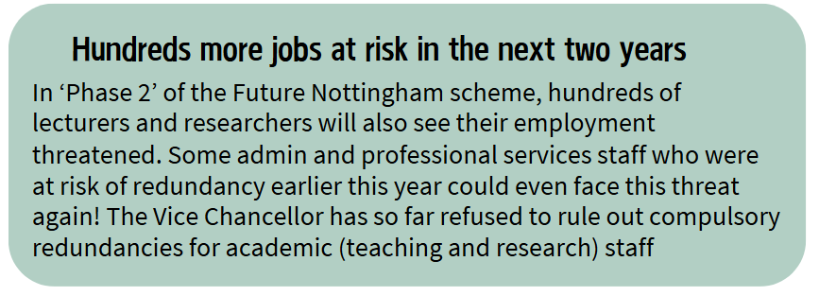
What caused UoN staff to go on strike?

Slide 5
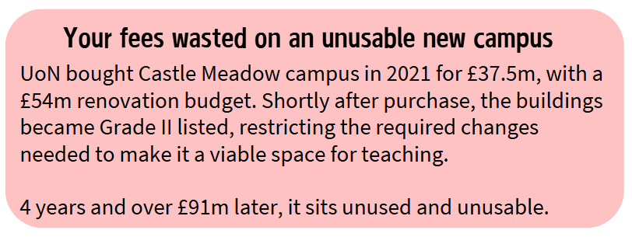
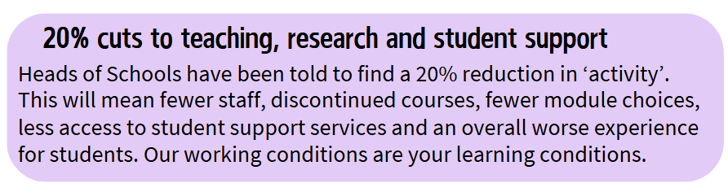
What caused UoN staff to go on strike?

Slide 6
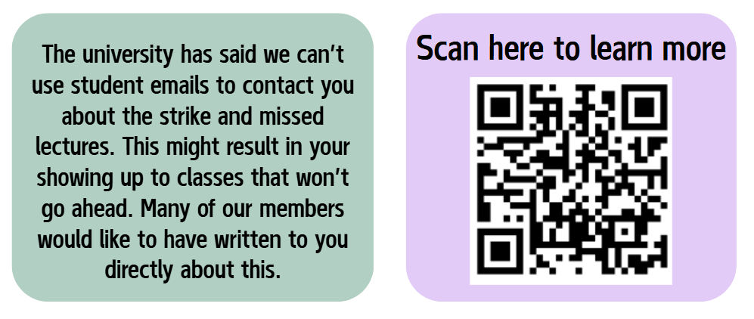
Why am I only just hearing about this?

Slide 7
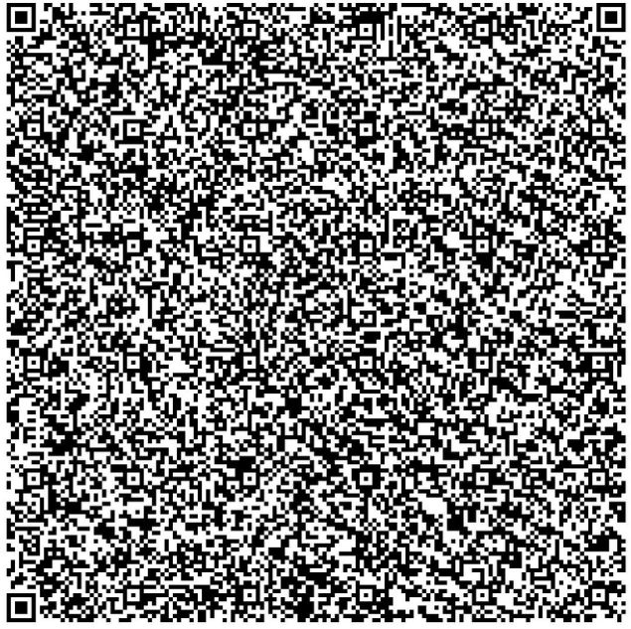
What can students do to support?
Use the QR code here to email the Vice Chancellor and Head of Council encouraging them to engage with UCU in negotiations to end the dispute. Explain how their choices to cut staff and spend money irresponsibly are impacting on your education
You can also raise these concerns to your Faculty PVC or Head of School, highlighting the local impact on students from your course, and asking that they add to this support of negotiations
Join us at teach outs and rallies – full details are on uonucu.org
Talk to your lecturers and support staff, asking them about their experience of these issues
Talk to other students about the issue, share what you know!

